Slide 1

Machine vision for Early Potato Disease Detection
Project 1
Garuda Aerospace Project Intern team

Slide 2
introduction
Background
Potato is one of the world's most important food crops, serving as a staple food for millions of people.
Potato crops are highly susceptible to various diseases, with early and late blight being the most destructive.
Early blight is caused by the fungus Alternaria solani, while late blight is caused by the oomycete Phytophthora infestans.

Slide 3
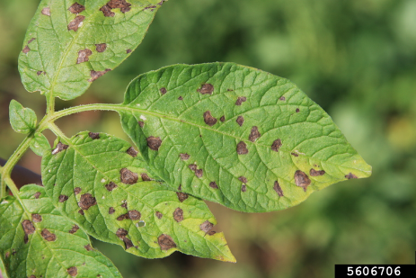
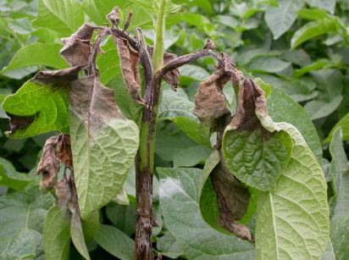
Early Blight
Late Blight

Slide 4
introduction
Significance of Early Detection
Early detection of these diseases is crucial for effective crop management.
Timely intervention can prevent the spread of the disease, reducing crop loss and ensuring food security.
Traditional methods of disease detection, such as visual inspection by experts, are time-consuming and may not be feasible for large-scale farms.

Slide 5
introduction
Technological Advancements
Advances in technology, particularly in the fields of computer vision and artificial intelligence, offer new solutions for agricultural challenges.
Deep learning techniques, integrated with image processing tools like OpenCV, have shown great potential in automating the detection of plant diseases.

Slide 6
introduction
Project Overview
This project aims to develop an automated system for detecting early and late blight in potato crops.
Utilizing TensorFlow and Keras for deep learning, combined with OpenCV for image processing, the system is designed to identify disease symptoms with high accuracy.

Slide 7
Problem statement
Potato crops are highly vulnerable to early blight and late blight, caused by Alternaria solani and Phytophthora infestans, respectively. These diseases can lead to significant crop losses, affecting food security and farmers' livelihoods. Traditional manual inspection methods are time-consuming, labor-intensive, and prone to error, highlighting the need for an automated, accurate, and scalable solution to detect these diseases early and efficiently.

Slide 8
objectives
The main objective of this project is to develop a deep learning model using TensorFlow and Keras that accurately detects early and late blight in potato crops. By integrating OpenCV for efficient image processing and feature extraction, the goal is to enhance the model's performance. Ultimately, the project aims to create a scalable and automated detection system that can be used by farmers and agricultural professionals to monitor and manage potato crop health effectively.

Slide 9
methodolgy
Data collection
Sources of data (e.g., images of healthy and diseased potato plants)
Data preprocessing steps
1
2
Model Development
Overview of TensorFlow and Keras
Description of the neural network architecture used
3
Integration with OpenCV
How OpenCV is used for image processing and feature extraction
AI FOR EARLY POTATO DISEASE DETECTION

Slide 10
Code
GitHub repository
https://github.com/yogarajn/Potato-disease-image-processing
Drive link
https://drive.google.com/drive/folders/1bjmlTNCWDsfEdTntsNet943FCYJ4YY8V

